Slide 1
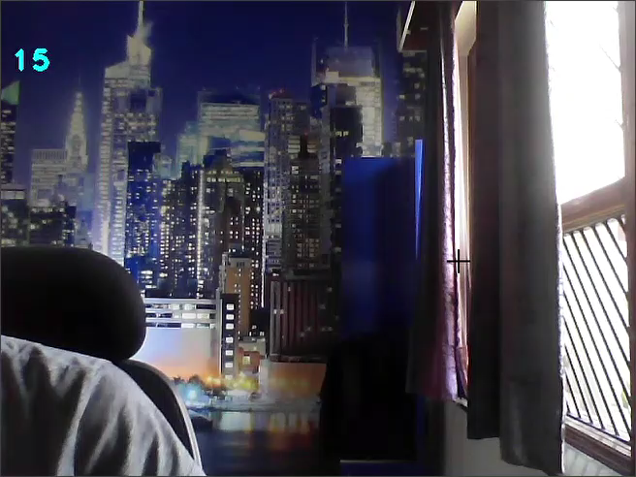
Using a module called Mediapipe and some other basic modules in python I first detected the hand and drew some landmarks on it as you can see, and then using the position of the tip of my index finger I changed the position of the mouse and controlled it. In order to click, I open my middle finger along with the index finger and then bring its tip close enough to the tip of my index finger for the program to detect it and click the mouse on its position

Slide 2
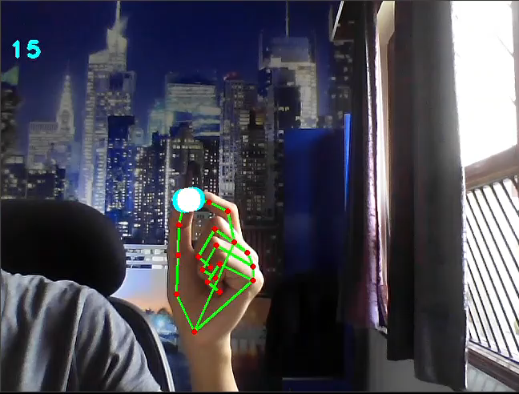
Here I calculated the distance between the tip of my thumb and index finger, interpreted it in such a way that the value which comes out is between 0-100 with the help of Numpy. Then I used this value to change the volume accordingly.

